Slide 1
CREDIT RISK ANALYSIS
SYSTEM
Predicting Loan Approval and Credit Risk Using Machine Learning
Data Science Capstone Project

Slide 2
INTRODUCTION
Project Objective
Build a data-driven system that helps financial institutions evaluate whether a loan applicant is likely to repay or represent a credit risk.
614
•
Analyze
Customer financial & demographic data
applicant records analyzed
•
Classify
Low-risk vs. high-risk applicants
3
•
Predict
Loan approval probability
ML models trained & compared
•
Visualize
Risk insights via an interactive dashboard
5
•
Recommend
Approve / Review / Reject, automatically
project modules delivered
2

Slide 3
DATASET
Loan Prediction Dataset
A widely-used, real-world-style dataset for credit risk and loan approval classification.
Demographics
Financials
Risk & Location
• Gender
• ApplicantIncome
• Credit History
• Married
• CoapplicantIncome
• Property Area
• Dependents
• LoanAmount
• Education
• Loan Amount Term
• Self Employed
Target variable: Loan Status (Y = Approved, N = Rejected) • Loan ID dropped (unique identifier, no predictive value) • No duplicate rows or columns found
3

Slide 4
MODULE 1
Data Preprocessing Decisions
1
Missing Values
2
“3+” Dependents
Categorical columns filled with mode; numeric columns (Loan Amount, Loan Amount Term) filled with median due to right-skew and outliers.
Encoded as the floor value 3, since the dataset does not record exact counts beyond this threshold. Kept numeric, as dependent count is genuinely ordinal.
3
Encoding
4
Feature Scaling
Binary variables (Gender, Married, Education, Self-Employed) mapped to 0/1. Property Area one-hot encoded (3 unrelated categories, drop_first=True).
StandardScaler fit only on training data, then applied to test data — preventing data leakage; primarily benefits Logistic Regression.
4

Slide 5
MODULE 2 · EXPLORATORY DATA ANALYSIS
Credit History Drives Approval
79.1%
approval rate for applicants with GOOD credit history
7.9%
approval rate for applicants with BAD credit history
Correlation with Loan Status: 0.54 — by far the strongest of any feature in the dataset.
5

Slide 6
MODULE 2 · EXPLORATORY DATA ANALYSIS
Income & Loan Amount Barely Matter
A counterintuitive finding: how much an applicant earns, or how much they request, shows almost no relationship with approval outcome.
Difference of just ₹62 in average income, and ₹6 in average loan amount, between approved and rejected applicants.
6

Slide 7
MODULE 2 · EXPLORATORY DATA ANALYSIS
Secondary Risk Factors
Education, marital status, and property area show mild effects — real, but far smaller than credit history.
Education
Graduate — 70.8%
Not Graduate — 61.2%
Marital Status
Married — 71.8%
Unmarried — 62.9%
Property Area
Semiurban — 76.8%
Rural — 61.5%
Gender, Self-Employment status, and Dependents were also examined but showed negligible variation, and are omitted for brevity.
7

Slide 8
MODULE 3 · PREDICTION MODEL
Comparing Three Algorithms
All values in % · 75/25 train-test split, random_state = 0
8

Slide 9
MODULE 3 · PREDICTION MODEL
Why Random Forest Won
Logistic Regression scores highest on paper — but a Credit Risk System must catch genuinely risky applicants.
Final model: Random Forest
▸
Correctly identifies 58% of genuinely risky applicants — vs. only 47% for Logistic Regression
▸
A missed risky applicant (false approval) is costlier than an overly-cautious rejection
▸
Strong balance of accuracy (79.9%) and risk detection
▸
Logistic Regression coefficients kept as a supplementary, explainable tool
9

Slide 10
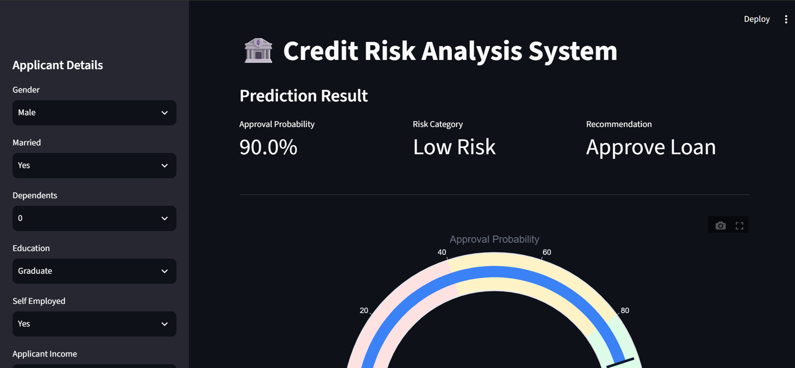
MODULE 4 · RISK SCORE DASHBOARD
Live Applicant Prediction
An interactive Streamlit dashboard that takes applicant details and instantly returns a risk assessment.
📷 PASTE SCREENSHOT HERE
Screenshot 1: Sidebar input form + Prediction Result
(approval probability, risk category, recommendation banner)
●
Sidebar form collects all 11 applicant attributes
●
Random Forest model + saved scaler generate a live prediction
●
Risk category: Low / Medium / High
●
Approval probability displayed as a percentage
10

Slide 11
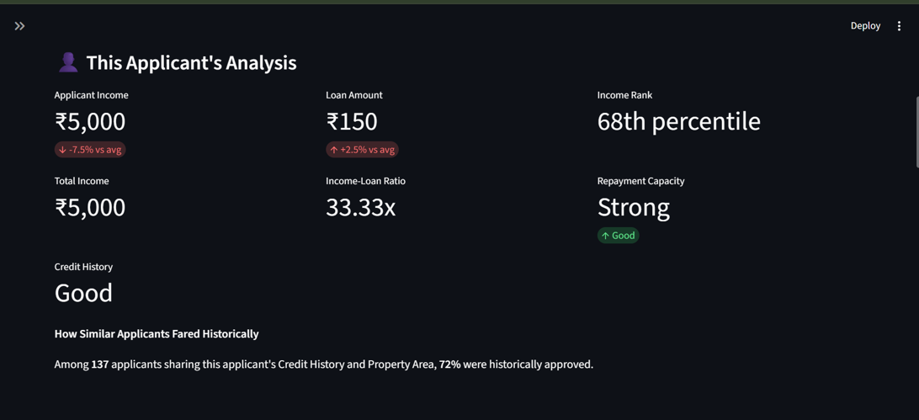
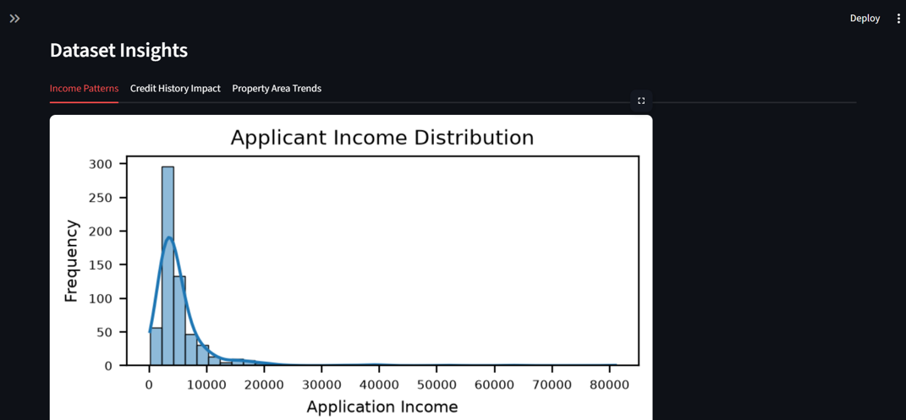
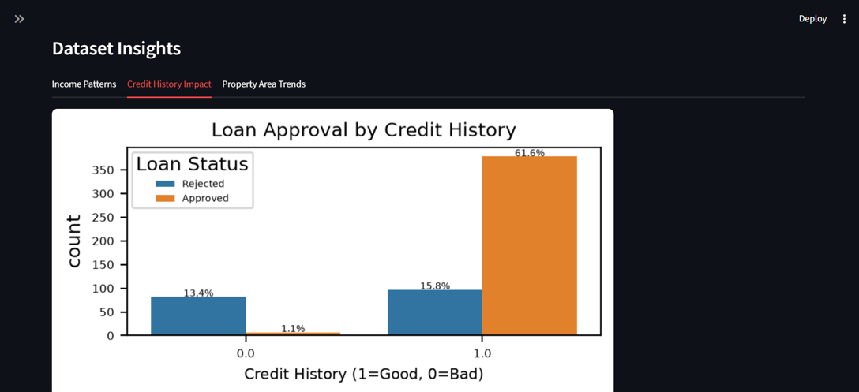
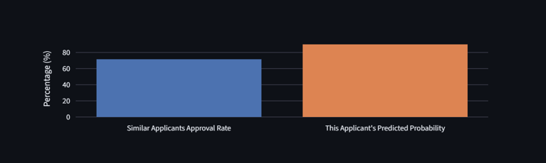
MODULE 4 · RISK SCORE DASHBOARD
Applicant Analysis & Dataset Insights
📷 PASTE SCREENSHOT HERE
Screenshot 2:
"This Applicant's Analysis" section
(gauge chart, income-to-loan ratio,
similar-applicants comparison,
feature importance chart)
📷 PASTE SCREENSHOT HERE
Screenshot 3:
"Dataset Insights" tabs
(Income Patterns, Credit History Impact,
Property Area Trends)
11

Slide 12
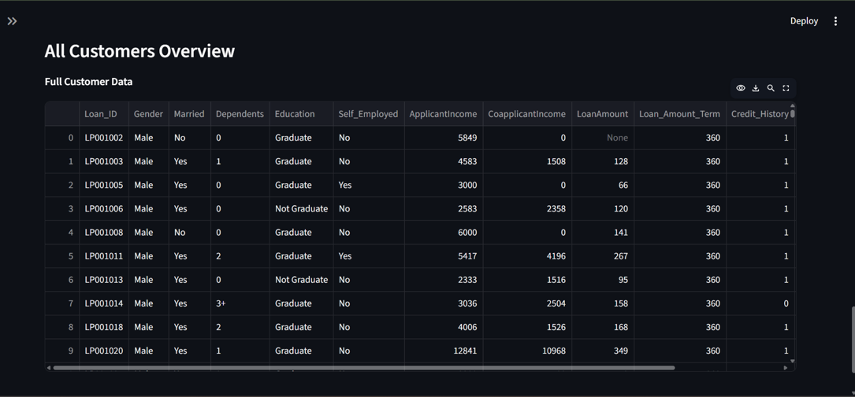
MODULE 4 · RISK SCORE DASHBOARD
All Customers Overview
A filterable, sortable table of the full customer base with human-readable labels.
📷 PASTE SCREENSHOT HERE
Screenshot 4: "All Customers Overview" table
with the Property Area filter dropdown visible
12

Slide 13
MODULE 5
Final Recommendation System
Built directly into the dashboard — the recommendation always stays consistent with the displayed risk score.
≥ 80%
40–79%
< 40%
Approve Loan
Review Manually
Reject Application
High predicted approval probability
Borderline case — flagged for human review
Low predicted approval probability
This tiered logic avoids a rigid binary decision — mirroring how real lenders balance automation with human oversight.
13

Slide 14
HONEST ASSESSMENT
Limitations
Dataset size
Dependents capping
Only 614 records — small relative to real-world lending data.
“3+” encoded as 3; model unreliable beyond that range (dashboard input restricted to 0–3).
Proxy target variable
Class imbalance
Loan_Status (approval decision) used as a proxy for repayment risk — not actual default outcomes.
68.7% Approved vs. 31.3% Rejected; addressed via precision/recall/F1, not accuracy alone.
Feature exclusion
Defined scope
Total_Income engineered for EDA but excluded from modeling (redundant with ApplicantIncome + CoapplicantIncome).
No deep learning, real banking integrations, or large-scale cloud infrastructure, per project scope.
14

Slide 15
CONCLUSION
Credit History Drives Approval — Not Income
This project delivered a complete, end-to-end Credit Risk Analysis System — from data preprocessing and exploratory analysis, through model comparison, to a deployed interactive dashboard with an integrated recommendation engine. Across every chart and the correlation analysis, Credit History emerged as the dominant driver of loan approval, far outweighing income, loan amount, and demographic factors.
Future Work
▸ Train on actual repayment/default data, not just approval decisions
▸ Incorporate additional indicators — existing debt, employment tenure
▸ Apply cross-validation for more robust performance estimates
▸ Deploy to Streamlit Community Cloud for public accessibility
Thank You

